Slide 1
1. A Probabilistic Simulation Framework to Assess the Impacts of Ridesharing and Congestion Charging in New York City

Slide 2
Research Focus
Key Objective: Develop a data-driven framework to assess the impacts of transportation interventions like ridesharing and congestion pricing in NYC.
Key Challenges: The complexity of urban transportation systems, incomplete data, and the need for probabilistic modeling for impact assessment.
Proposed Solution: An individual-level simulation framework using a Bayesian inference model to handle incomplete mobility data.

Slide 3
Methodology:
The MNL model is used to estimate mode choices based on travel time, cost, and other factors.
Nested MNL helps to model related transportation modes more accurately.
Agent-based simulations are used to model individual-level behavior.
Neural Networks estimate parameters and simulate mode-choice probabilities.
Bayesian inference is used to handle uncertainty and refine predictions.

Slide 4
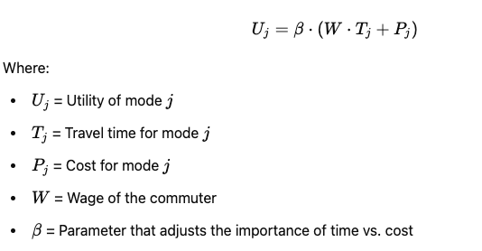
Multinomial Logit (MNL) *baseline approach in this paper
Multinomial Logit Model (MNL)
MNL is a discrete choice model used to model how individuals choose between several options (like different transportation modes) based on their preferences.
It assumes that each choice (mode of transport) has a utility (satisfaction level) associated with it, which depends on various factors such as time, cost, and personal preferences.
The probability that someone chooses a certain mode is calculated by comparing the utilities of all available choices. The higher the utility of a mode, the higher the probability of choosing that mode.
This formula essentially says that the utility for a mode depends on the time cost (travel time multiplied by the commuter's wage) and the monetary cost.

Slide 5
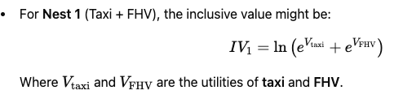
Nested Multinomial Logit (Nested MNL)
The authors also use a nested version of the MNL model. In some cases, transportation modes are more similar to each other than to others (e.g., taxis and FHVs might be more similar to each other than to public transit).
In Nested MNL, modes are grouped into nests, and within each nest, choices are correlated. This allows the model to better account for how similar choices are more likely to be selected over others.
For example, they might group taxi and FHV (for-hire vehicles) in one nest and shared FHV in another.
The inclusive value is a weighted average of the utilities of all modes within the nest.

Slide 6
Agent-Based Model (ABM)
Agents: Each commuter in the simulation is treated as an individual agent.
The agents can have different characteristics, such as income, wage, and location.
Each agent has a set of choices when it comes to transportation modes (e.g., taxi, FHV, public transit, etc.).
Utility Calculation for Each Mode: The utility for each agent is calculated for each available mode of transport using a utility function:
Utility for mode j: Uj​=β⋅(W⋅Tj​+Pj​), where W is the commuter's wage, Tj is the travel time for mode j, and Pj s the cost for that mode.
For each agent, the model calculates the utility for every available mode.
Choice Simulation: Once the utility scores are calculated, each agent will choose a transportation mode based on the utility values. The choice is simulated in a probabilistic way (not deterministic), meaning that:
If one mode has a higher utility, the agent is more likely to choose it, but it’s not guaranteed. This randomness is modeled using probability.
Mode Shift: After applying the intervention (e.g., introducing ridesharing or congestion pricing), the model calculates how the agents’ transportation choices shift in response to these changes.

Slide 7
Combining Bayesian Inference and Neural Networks in Agent-Based Model (ABM)
Agent-Based Model (ABM): Simulates individual commuter behavior based on characteristics like income, travel time, and cost preferences.
Neural Networks (NN): Learn complex relationships between input features (time, cost) and mode choices (taxi, FHV, etc.), adjusting model parameters during training for better predictions.
Bayesian Inference: Handles uncertainty and incomplete data by updating model parameters with probabilistic distributions. Provides confidence intervals for predictions.
Bayesian Neural Network (BNN): Combines NN and Bayesian inference, allowing the model to learn from data while accounting for uncertainty. Outputs mode-choice probabilities with confidence levels.

Slide 8
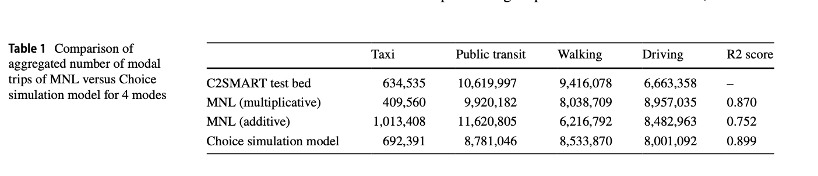
Results:

Slide 9
Impact Assessment Overview
Transportation Interventions:
Shared FHVs Introduction (2014)
Manhattan Congestion Surcharge (2019)
Key Findings & Impacts
Impact of Ridesharing (Shared FHVs)
Simulation Model: Mode-choice analysis with and without shared FHVs.
Travel time: -1.77%
Mileage: +1.14%
Economic Impact: $4.72M in time-cost savings
Traffic: Majority shifts from private vehicles; 30% replaces transit/walking, increasing traffic.
Equity: High-income groups benefit more; low-income groups cause heavier traffic with smaller time savings.
Impact of Manhattan Congestion Surcharge
Travel time: +1.09%
Mileage: -0.87%
Mode Shift: Shift from taxis/FHVs to public transit.
Economic Impact: $2.7M time-cost value increase
Equity: High-income groups more affected; low-income groups less impacted

